Slide 1
Goals setting & Action Plan

Slide 2
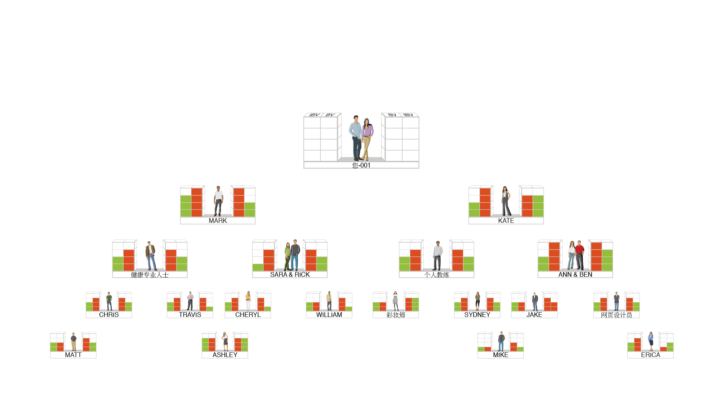
AS YOUR ORGANIZATION EXPANDS
The frequency of commissions earned increases until it occurs weekly
5000 / 5000 = RM2,400
3600 / 3600 = RM1,200
2400 / 2400 = RM1,200
1200 / 1200 = RM1,200
RM6,000
5000 / 5000 = RM2,400
3600 / 3600 = RM1,200
2400 / 2400 = RM1,200
1200 / 1200 = RM1,200
RM6,000
BV
5000
5000
IBV
3600
3600
2400
2400
1200
1200
TOTAL WEEKLY POTENTIAL RM12,000 PER BDC

Slide 4
EARN MORE INCOME
Each UnFranchise Owner starts with three Business Development Centers Total weekly potential is RM14,400 per BDC
Total weekly earning potential is RM43,200
Notes:
您-001
您-002
您-003

Slide 5
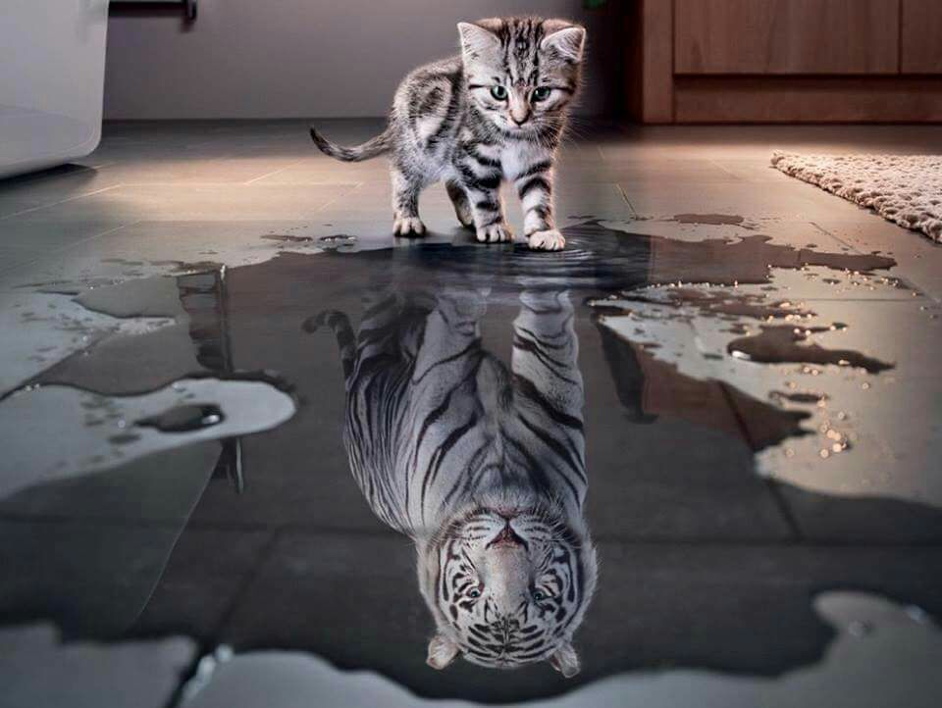
Your level of desire is the only limit to what you will achieve

Slide 6
Law of Attraction

Slide 7
Ideas Become Facts
What people can
imagine and believe
in their hearts
will eventually become true

Slide 8
Goals And Goal Statements
Draw a blueprint for your dream
Know your purpose
Translate your Dream and Purpose into a Plan of Action!

Slide 9
set your goals
Life
Love
Learn
Give
New house or pay off mortgage
New car & boat
Debt-free
Vacation & other things you want to do
More time & choices
Gifts for spouse, romantic weekends...
Give gifts to friends and family...
Second language, musical instrument...
Cooking, flying, diving...
New skills, new hobbies...
Establishing funds, scholarships
Help others, charities...
Inheritable assets or trust funds

Slide 10
Example
Write it out: Goal Statement
“By December 31st, 20__, I will be a free person with zero credit card debt. I shall live in a 5,000 sqft. mansion built with bricks on the East Coast. I will drive a Porsche and take 4 months off each year for vacation. My marriage will be so much better than before because of less economic stress. There will be more precious time with my family. We will often do the things we like together.”
50～100 words – read it twice each day
Add Your “Action Plan”

Slide 11
Goal Statement
November, 2020, shortly after the 3 conventions (Singapore, Malaysia, Taiwan),
our family sets off for the United States to meet with our daughter! Ready to embark on a driving tour of the United States!!
Go into Disney Land once again to celebrate my 40th birthday!!
Grand Canyon, Yellowstone Park, San Francisco Redwood Park. Enjoy these gorgeous locations while singing in the car ～
Return to Singapore to look at real estate. While I am searching for a second house overseas,
great news is brought by my partner ZhenXun through Line.
A total of 300 partners attended this Malaysia Convention!!
Brother Ma, Meizhen, along with David, Rebacca and Carol from Sarawak
have also completed an SC shop after the convention! They now truly enjoy the freedom of controlling their finances and time!
I am savoring breakfast prepared by myself, chatting with my partners in Taiwan, Singapore and Malaysia via ZOOM.
We plan to spend New Year’s Eve together in Japan on December 31st!
We rent the entire homestay! Everybody sips warm sake while reminiscing about all of our blood, sweat and tears we’ve shared in the past three years ～
Here goes the bell in the Japanese Temple! Embrace a greater 2021!!

Slide 12
Goal Statement
April 2020 ⋯ 6 years have passed!
Together with my partners, I visit my mom's dream villa
We are looking at some old photos
I have made every single one of my dreams that I chased six years ago come true
Became PC, traveled around the island by sea, air, land
Became SC, helped more than ten partners reach an annual income of over a million Taiwan dollars
Became NSC, my wife and I spent our honeymoon at the most amazing coast in Greece
Today I am a Director...
I am about to finish my micro film. Everything is so surreal
I am ordinary, yet my extraordinary dream has come true
Thank you, my sponsor! Thank you, Market America!

Slide 13
Your big why ?

Slide 14
Dream Board

Slide 15
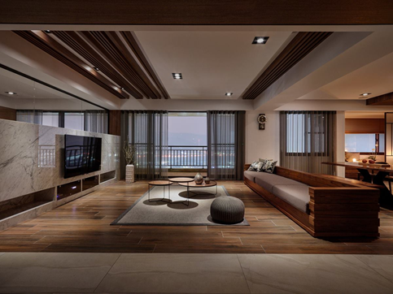
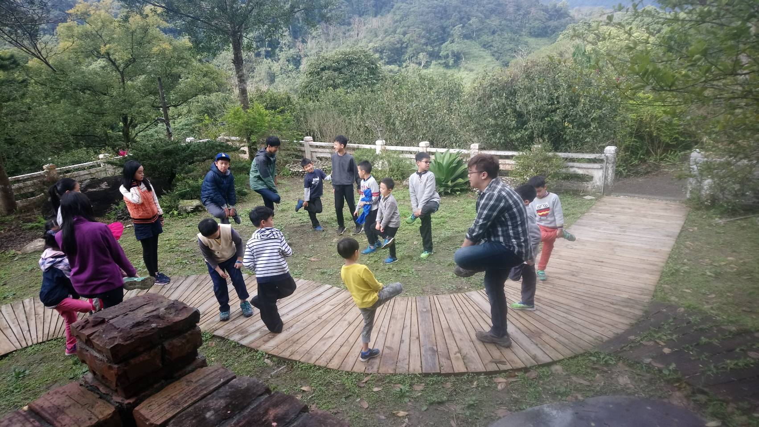
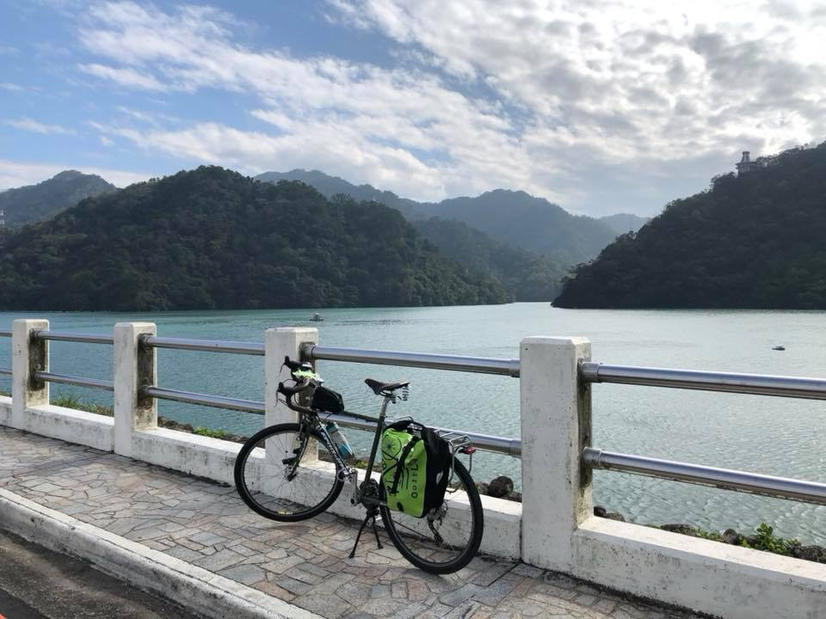
Johnny’s Dream Board (2007)
50
50
美國
美國
1. A life w/o alarm clock
2. Earn passively
3. Let my wife & mom live like queens
50
50
50
50
7. Do my own thing (cycling round the whole island)
4. Dream house
美國
美國
美國
美國
5. Have children go to forest school
6. Car w/ great comfort & quality

Slide 16
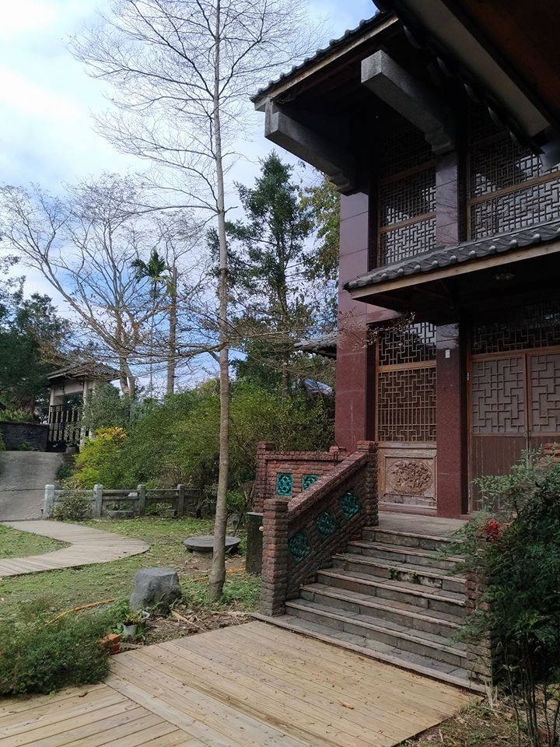
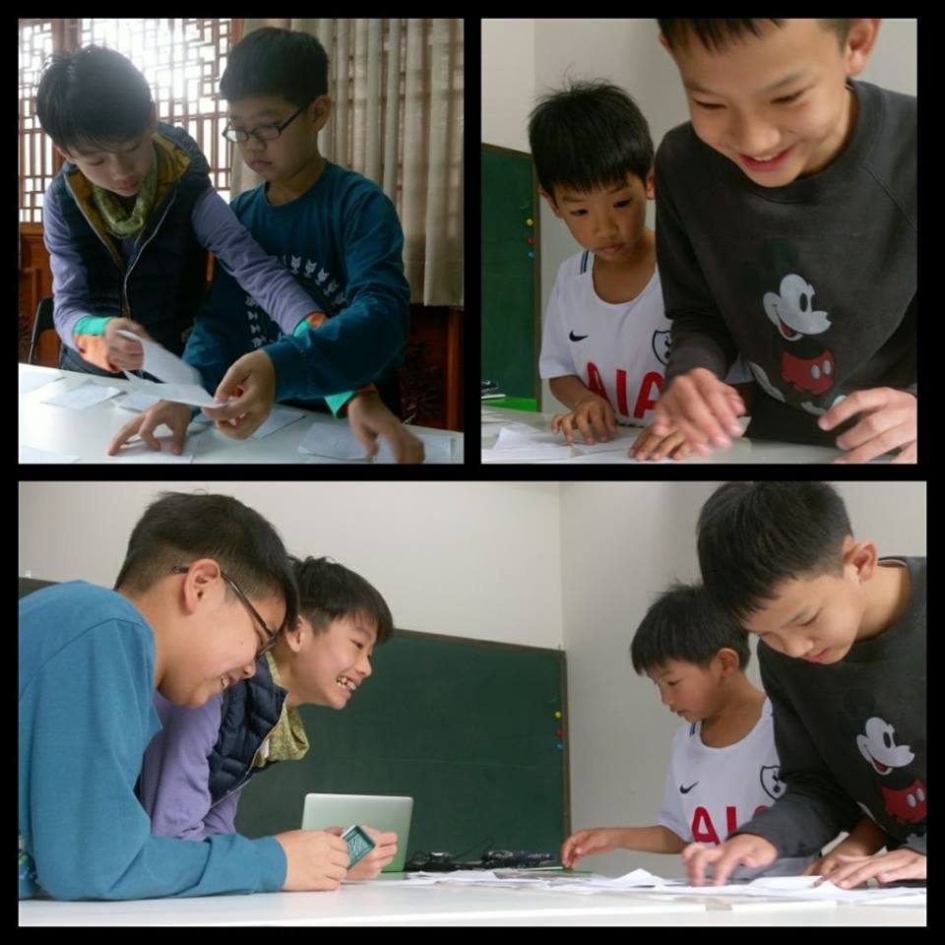
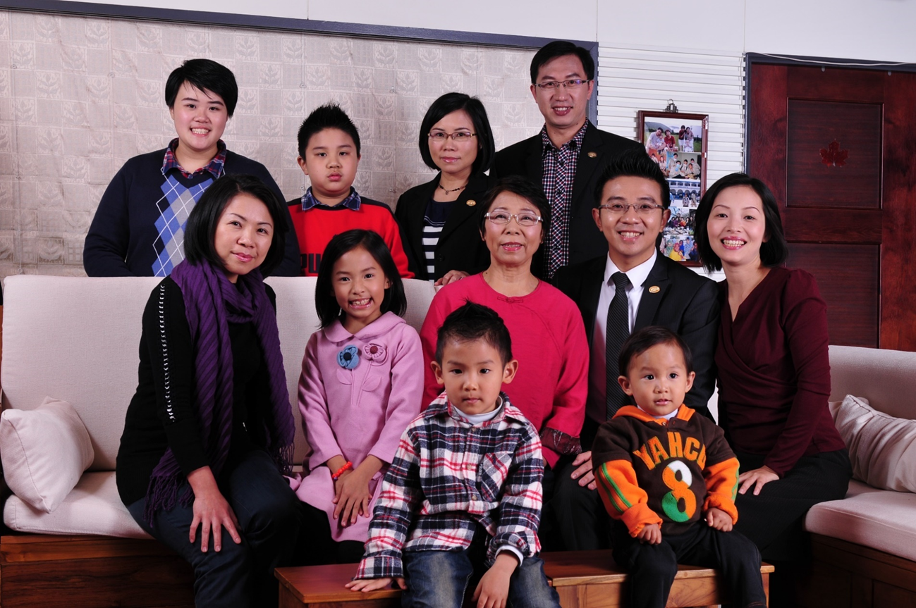
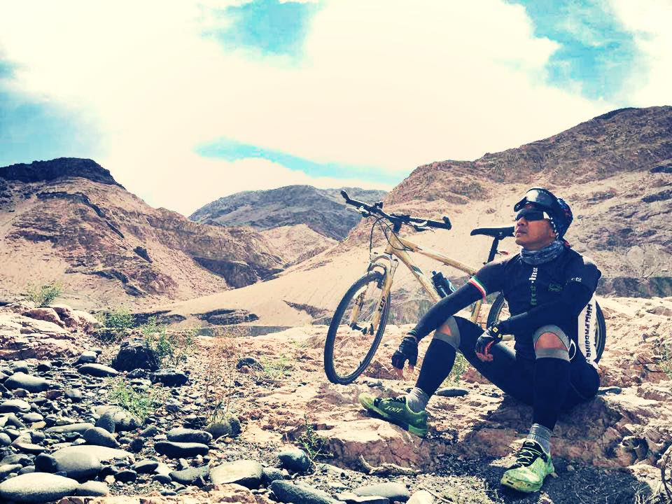
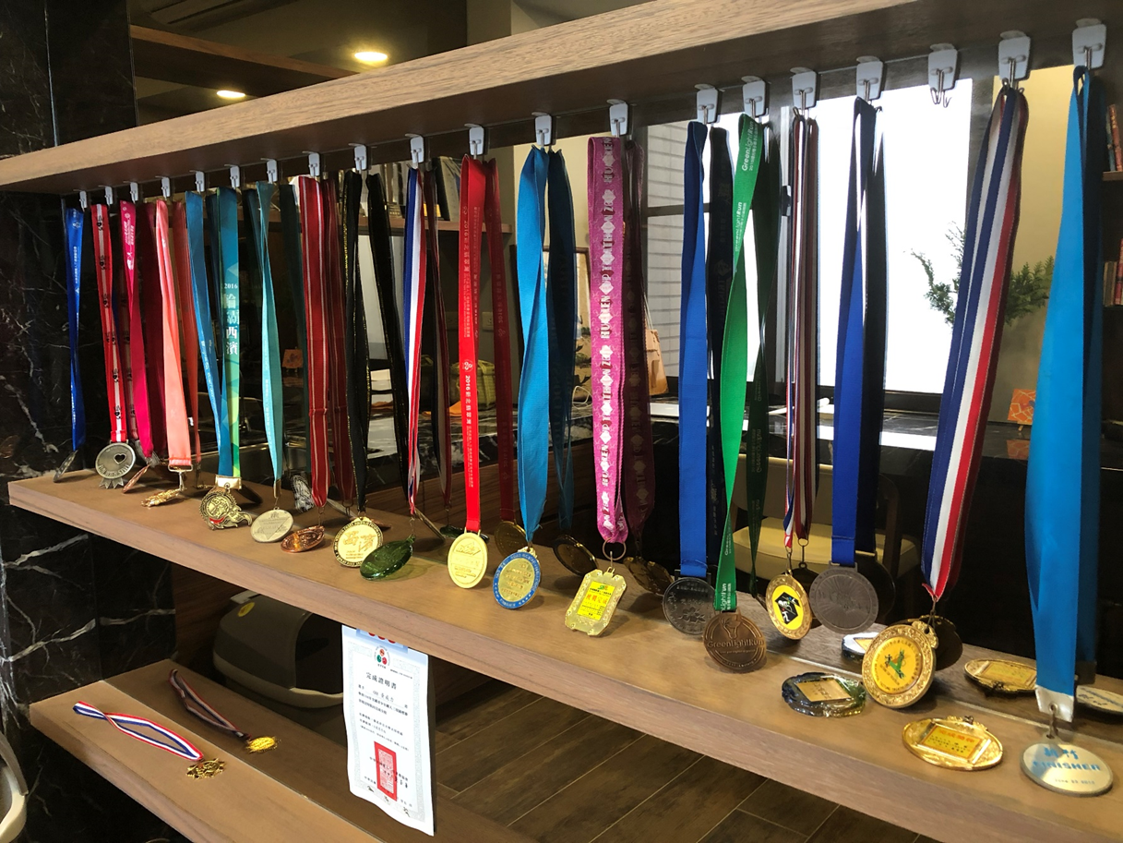
Dreaming
Help other families
Have time w/kids;
build schools
Help my family
Charity
Support more than 50 children
Triathlon 113K Challenge
Silk road bike riding
Write books, donate royalties

Slide 17
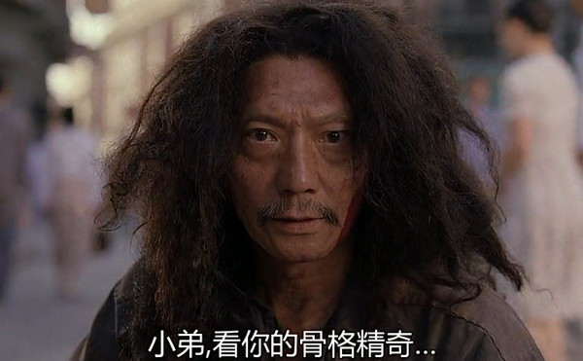
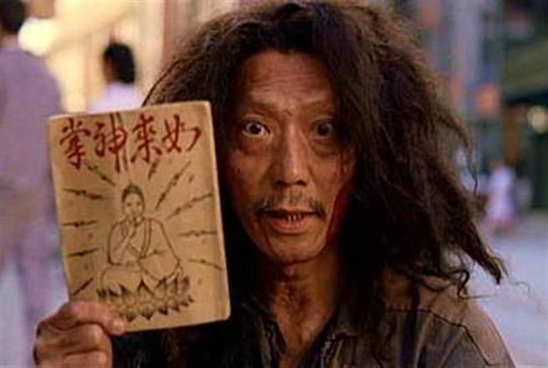
Would you like to make your dreams come true?
我这ㄦ有本秘笈
Hey, young man! You have a very unique body build…
I have a secret manuscript of Kung Fu

Slide 18
One must first “suffer”
In order to succeed

Slide 19
For 2-3 years
8-15 hours/week

Slide 20
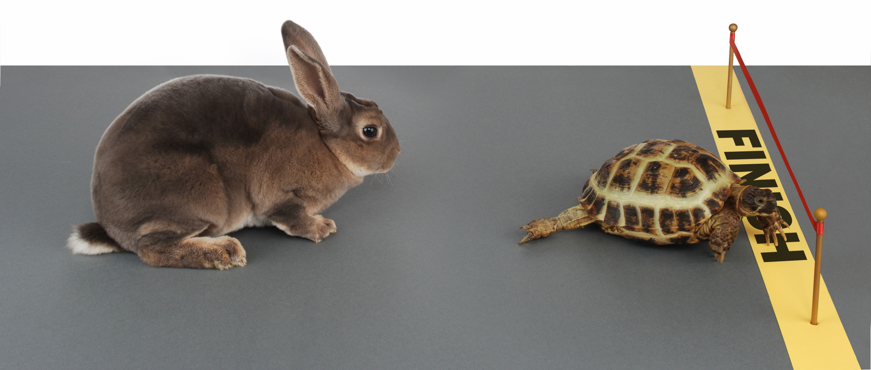
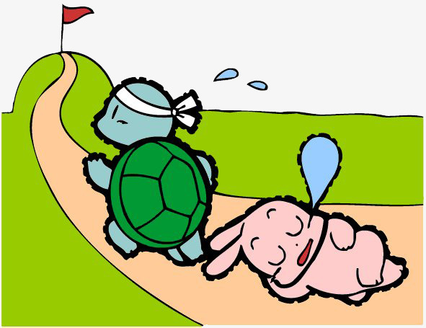
～ Persist
The Tortoise And The Hare

Slide 21
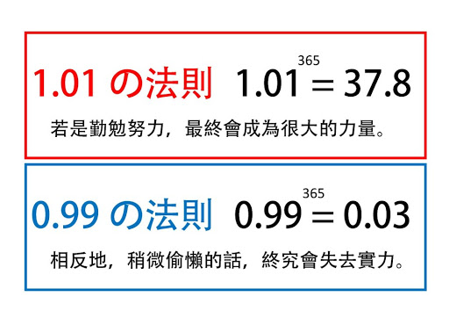
The Power Of Persistence

Slide 22
Set your goal (Business plan – 5 steps)
what is the specific goal
when to achieve it
costs or difficulties
detailed plan
write it out (1 through 4) and read it twice daily
RM6,000/month RM30,000/Supervising Coordinator
Within 1-2 years
Within 2-3 years
Mind Time Money
Master UFO Chairman’s Challenge Buy & Sell Tickets
Notes:
22
22

Slide 23
Detailed plan breakdown:
Monthly plan
Divide the annual plan into 12 months
Weekly plan
Divide the monthly plan into 4 weeks
Daily plan
Divide the weekly plan into 5 days
“If you want things to change, change your Daily Goals first”

Slide 24
Weekly Goals
Goal Staircase to RM8,400/week
Talk to 5-15 people
Set 5 appointments
Develop 10 leads
Daily Action
5
4
3
everyday
2
1
Social Media
Read Goal Statement
Listen to Audios
Talk to 1-3 people
Schedule an appointment
Add 2 names to the Leads List

Slide 25
Weekly Goals
Goal Staircase to RM8,400/week
Talk to 20-60 people
Set 20 appointments
Develop 40 Leads
weekly action
Weekly
Goals
5
4
Weekly
Goals
3
2
1
Week 4
5
4
Weekly
Goals
3
2
Week 3
1
Every Week
Show The Plan once
Follow up on 1 prospect
Bring guests to UnFranchise Business Presentation (UBP)
Add 1 new customer
Call your senior partner
5
4
3
2
Week 2
1
5
4
3
2
Week 1
1

Slide 26
Annual Goal
Goal Staircase to RM8,400/week
Determine your goal; earn RM14,400/week ongoing income
monthly action
12
11
10
9
8
7
Every Month
Show The Plan ＞4 times
Sponsor 1 UFO (min 2/quarter)
10 customers purchasing ≥ 30 BV and ≥ 20 IBV monthly
Attend monthly seminar or training
6
5
4
3
2
1

Slide 27
Time Management & Action Plan (8~15 hours/week)
 | Monday | Tuesday | Wednesday | Thursday | Friday | Saturday | Sunday
Morning
Afternoon
Evening

Slide 29
1. Master ufo 2. challenge 3. tickets 4. Make sure to have weekly coring training attendees
Goal setting

Slide 30
1. Master ufo
Goal setting
8
+ 8 = 16
(BDC 001)
(BDC 002 ~~)

Slide 31
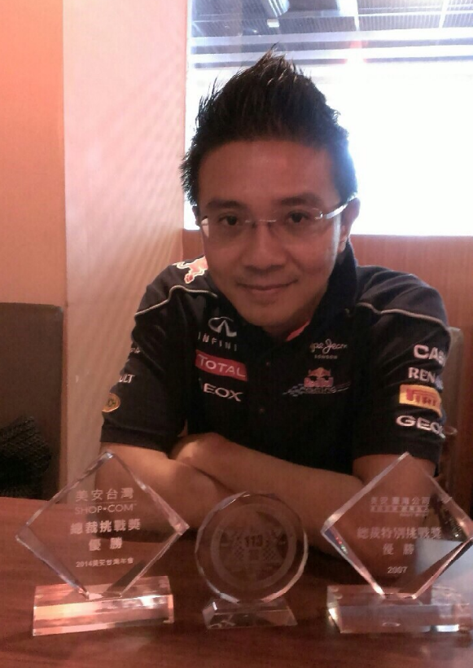
2. chairman’s challenge
Goal setting
POWER OF “ONCE”

Slide 32
Goal setting
3. tickets
2
10
60

Slide 33
6 months (half-year) plan
STACY TUNG Local Seminar
22.23/6
KL
STEVEN HU
Local Seminar 21.22/9
KL
LIN SHU TING
Local Seminar 28.29/9
Penang
Nov. Leadership School
May Convention
May
June
July
Aug
Sep
Oct
Nov

Slide 34
Monthly Plan
U
B
P
B5
Team Coring
Week 1
Week 2
Week 3
Week 4

Slide 35
Weekly Plan
HBP
UBP
Monday
Tuesday
Wednesday
Thursday
Friday
Saturday
Sunday
The change of Quantity can create Quality change

Slide 36
4. Make sure to have weekly coring training attendees
Goal setting
Coring is almost as important as a Convention

Slide 37
Coring Team gathering
1. attend
2. participate
3. create your own coring

Slide 38
Three-year plan for success
12 months | 6,000
6 months | 6,000
4 months | 6,000
3 months | 6,000
2 months | 6,000
1 month | 6,000
3 weeks | 6,000
2 weeks | 6,000
1 week | 6,000
30 months/3 years | S$66,000 / 222,000
Last person standing

Slide 39
MA 2～3 Years Steps To Success
$ $ $ $ $ $ $ $ $ $ $ $ $ $ $ $ $
RM14,400/W
EFFORT
$ $ $ $ $ $ $ $ $ $ $ $
RM8,400/W
EFFORT
$ $ $ $ $ $ $
EFFORT
RM8,400/M
EFFORT
RM6,000/M
$ $
Notes:
39

Slide 40
The road to success is not crowded
because most people don’t have the STAMINA.

Slide 41
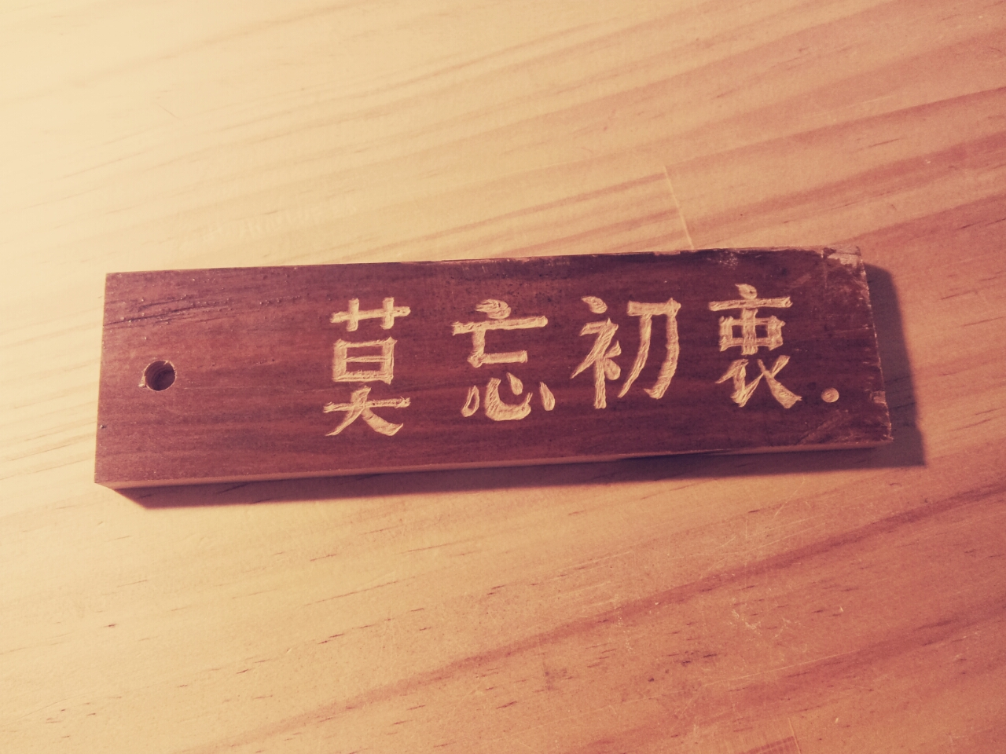
Never Forget Your “WHY”

